Slide 1
Dice.com Tech Jobs Analysis
By: Cameron Reilly, Olaa Kasem, Felix Owusu

Slide 2
Project Objective
Data set is gathered from www.dice.com
Locate areas with high amounts of jobs in technology based on:
Location
Frequently required skills
Employment type
Analyze how these fields overlap with each other. Eg.: Are skills in SQL more useful in California or in New York.

Slide 3
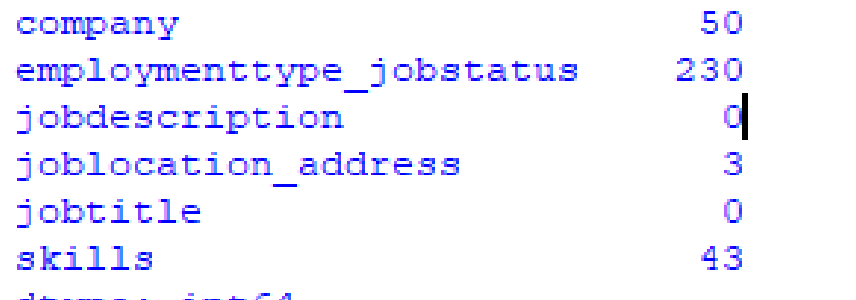
Data Preprocessing
Data Preprocessing is a technique that is used to convert the raw data into a clean data set.
Remove all not necessary columns: results in in 6 columns
{company, employment type, job description, job location, job title, skills}
Column names are consistent (all capitalized, no space )
{company, employmenttype_jobstatus, jobdescription, joblocation_address, jobtitle, skills}
Missing data values: detect rows with missing values(empty)
using python pandas library

Slide 4
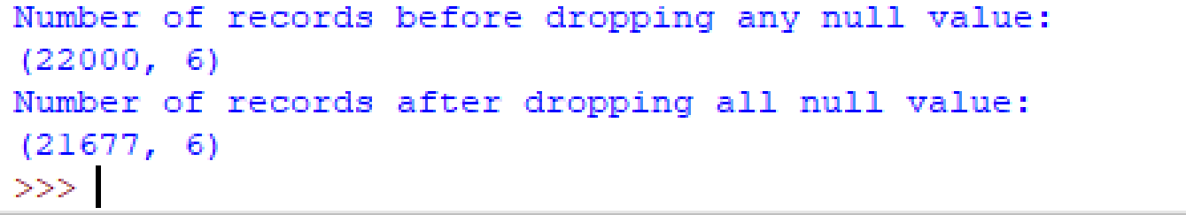
Data Preprocessing
Remove data with null/Null values

Slide 5
Data Analysis
Start working on Job Location column:
Atlanta, GA
Getting all values from the data set, split it by (,)
Store all cities in cities list
Store all states in states list
Find number of occurrences of each state and city mentioned in the data set
Need to work on visualizing data and find the overlap between location and other attributes.

Slide 6
NLTK

Slide 7
Visualizing data

